Slide 1

Web-Based Ordering & Ingredient estimating for bakery Manufacturer
progress report II presentation
Wednesday 29 october 2014
Miss. Nontra Mahachanont 542115026
Mr. Parinya Panyanak 542115034

Slide 2

agenda
Introduction
System Architecture
Project Status Report
Work list
Software Project Management Plan
Software Requirement Specification
Software Design
Software Implementation
Software Testing
Traceability Record
Demo
Problems
Next Progress

Slide 3
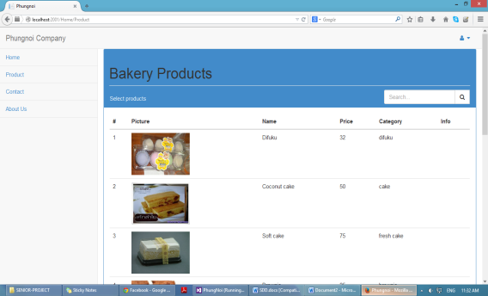
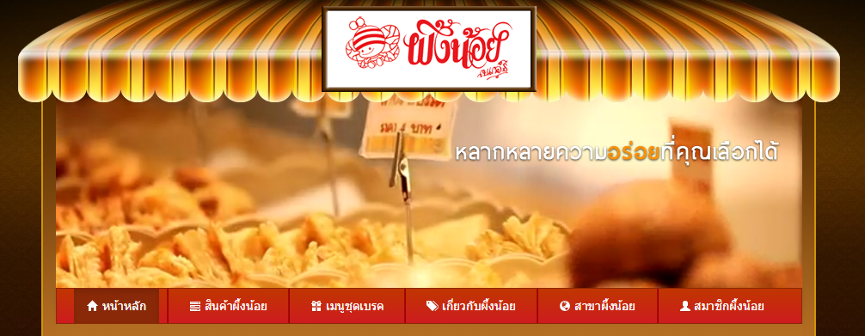


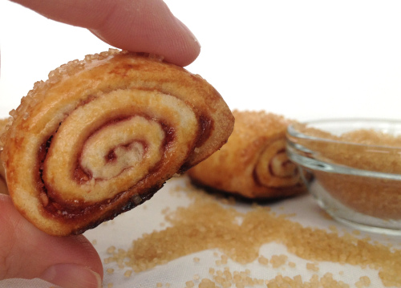
Introduction
Project is web application
Software for ordering bakery product
Software for estimating ingredient in manufacturer
Develop by C# & ASP.NET MVC

Slide 4
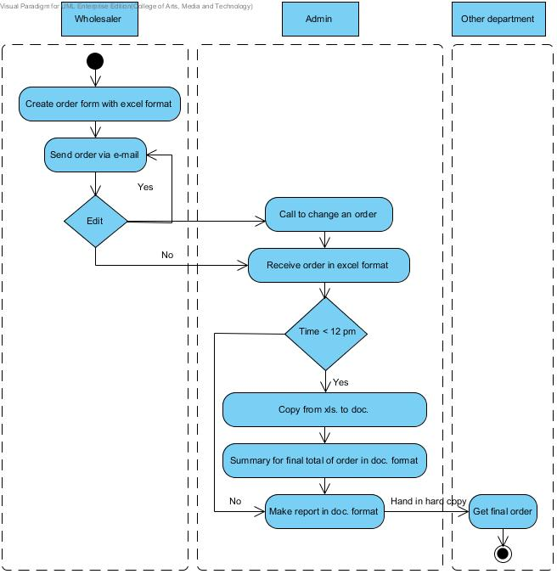
Traditional Workflow

Slide 5
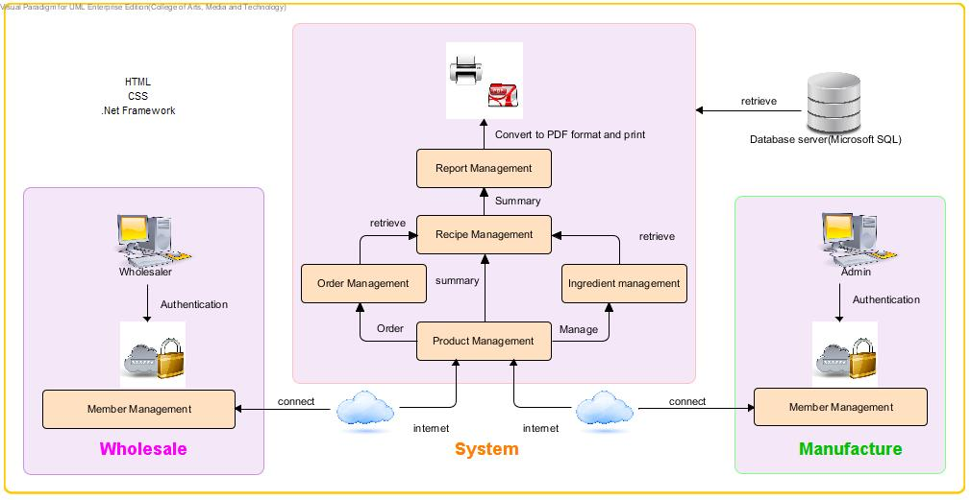
System architecture

Slide 6

Project status report
Project name: Web-based Ordering & Ingredient Estimating for Bakery Manufacturer
Prepared by: Nontra Mahachanont Parinya Panyanak | Date: 29 October 2014 |  | Report Process: Project Progress Report II
Project Overall Status: 70 %
Feature: Order Management and Ingredient Management - Wholesaler can order bakery product from the product list - Wholesaler can manage own order information - Wholesaler can view their current’s order information - Admin can view all current’s order information - Admin can mark progressive of order status - Wholesaler can view their progress order status - Admin can manage all ingredient information - Admin can view all ingredient information
Milestone Deliverables performance reporting
Milestone Deliverables | Due Date |  | % Complete | Deliverable Status
Project Progress Report II
Software Project Management Plan |  | 29 October 2014 | 100 % | On schedule
Software Requirement Specification |  | 29 October 2014 | 100 % | On schedule
Software Design Document |  | 29 October 2014 | 80 % | After schedule
Software Implementation |  | 29 October 2014 | 90 % | After schedule
Test Plan |  | 29 October 2014 | 90 % | After schedule
Test Record |  | 29 October 2014 | 100 % | On schedule
Traceability Record |  | 29 October 2014 | 100 % | On schedule

Slide 7

No. | Review Item | Responsibility | Reviewer
1 | Project Management Plan | NM | All members Advisor
2 | Project Proposal | All members | All members Advisor
 | Software Requirement Specification | NM | All members Advisor
3 | Software Design Document | PP | All members Advisor
4 | Implementation | PP | All members Advisor
 | Unit Test Report | PP | All members Advisor
5 | System Test Report | PP | All members Advisor
6 | Traceability Record | NM | All members Advisor
 | Project Status Report | NM | All members Advisor
 | Change Request | NM | All members Advisor
Work list in progress report II

Slide 8
Tasks in Project Progress Repot II
Estimate Duration
Development Model
Change Management
Configuration Item Table
Repository Tool
Software project management plan

Slide 9
Estimate duration
Progress | Duration | Tasks
Proposal | Start: 07 February 2014 End: 02 April 2014 | Proposal Document
Progress Report I | Start: 15 April 2014 End: 13 August 2014 | Feature#1: Member Management Feature#2: Product Management
Progress Report II | Start: 18 August 2014 End: 29 October 2014 | Feature#3: Order Management Feature#4: Ingredient Management

Slide 10
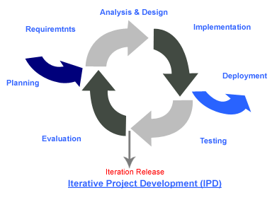
Development model
Iterative Software Development Process
We needed to develop the iterative way for review and improve the software and its documents for each development progress until it has finished.

Slide 11

Change management
No. | Item name | Baseline Version
1 | Project Proposal | 1.4
2 | Project Management Plan | 1.0
Specify version of each document.
Approving the change request by project advisor.
URS UTC | URS - 01 | URS - 02 | URS - 03 | URS - 04 | URS - 05 | URS - 06
UTC - 01 |  | X
UTC - 02 |  |  |  | X
Create requirement traceability to trace change document.

Slide 12
No. | Item name | File name | File Type | Owner (Role) | Repository (Path) | Baseline Version
1 | Project Proposal | Web-based Ordering & Ingredient Estimating for Bakery Manufacturer – Project Proposal_V.1.4 | .docx | PP, NM | C:\Users\VAiO\Desktop\Senior Project\Project Plan | 1.4
2 | Project Management Plan | Web-based Ordering & Ingredient Estimating for Bakery Manufacturer – PMP_V.2.0 | .docx | PP, NM | C:\Users\VAiO\Desktop\Senior Project\PMP | 2.0
3 | Software Requirement Specification | Web-based Ordering & Ingredient Estimating for Bakery Manufacturer – SRS_V.2.0 | .docx | PP, NM | C:\Users\VAiO\Desktop\Senior Project\SRS | 2.0
4 | Software Design Document | Web-based Ordering & Ingredient Estimating for Bakery Manufacturer – SDD_V.2.0 | .docx | PP, NM | C:\Users\VAiO\Desktop\Senior Project\SDD | 2.0
5 | Test Plan | Web-based Ordering & Ingredient Estimating for Bakery Manufacturer – Test Plan_V.2.0 | .docx | PP, NM | C:\Users\VAiO\Desktop\Senior Project\Test Plan | 2.0
6 | Traceability Record | Web-based Ordering & Ingredient Estimating for Bakery Manufacturer – TR_V.2.0 | .docx | PP, NM | C:\Users\VAiO\Desktop\Senior Project\TR | 2.0
Software configuration item table

Slide 13
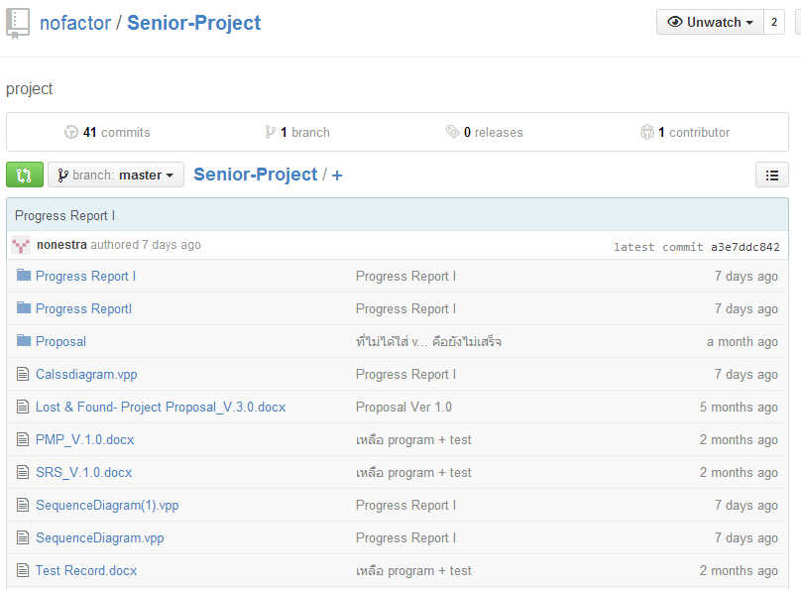

repository tool

Slide 14

Tasks in Project Progress Repot II
Analyze Requirement
Software Requirement Specification Document
14 User Requirement Specification (URS)
82 System Requirement Specification (SRS)
25 Activity Diagram (AD)
Software requirement specification

Slide 15
Example for URS
URS-07: Wholesaler can order bakery products from the product list. An order can select by input bakery product name, bakery product quantity and delivery date.
SRS-40: The system shall provide a link for ordering in the order product interface.
SRS-41: The system shall provide an order form in order product page for wholesaler input name of the bakery product, bakery product quantity and delivery date.
SRS-42: The system shall generate other information from input bakery name consist of bakery product ID, product price and product picture in each label of product list.
SRS-43: The system shall provide a calculating function to compute the total price and discount of each order.
SRS-44: The system shall provide a user interface to display the result of the total price and discount from all bakery product list.
Wholesaler side

Slide 16
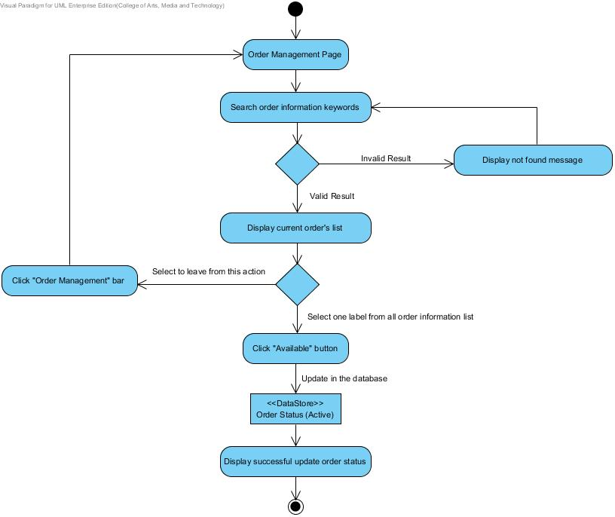
Example for activity diagram
AD-20
Admin mark order status
Admin side

Slide 17
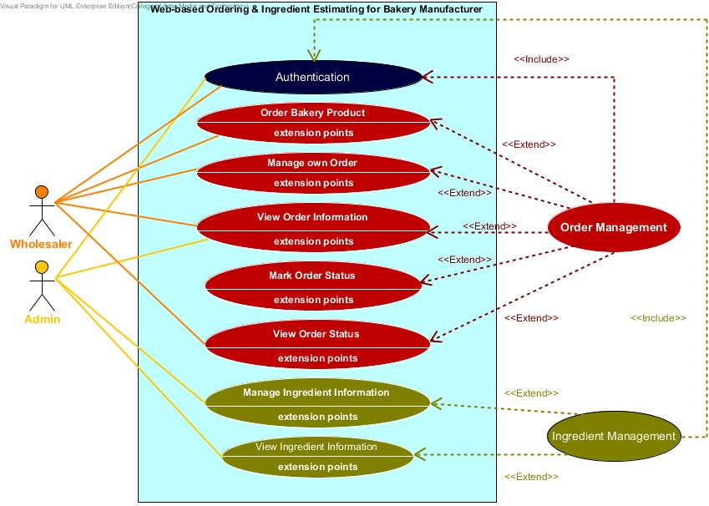
Requirement Analysis
Use Case
Scenario

Slide 18
Tasks in Project Progress Repot II
Class Diagram
Software Design Document
19 Sequence Diagram (SD)
25 User Interface Design (UI)
Database Design(DB)
Software design

Slide 19
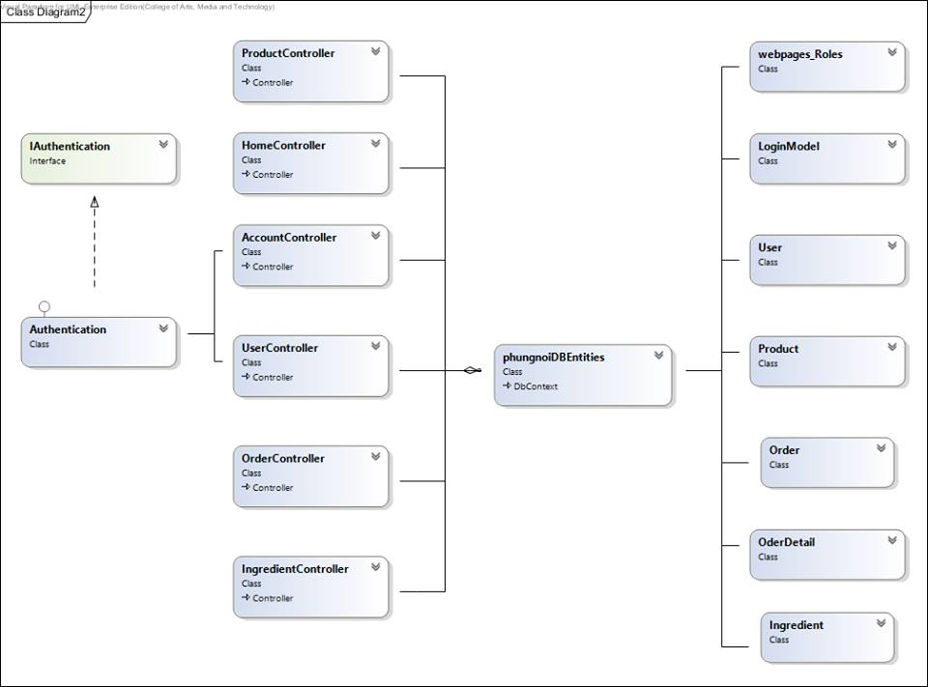
Example for class diagram

Slide 20
Example for
sequence diagram
SD – 15: Admin create ingredient information

Slide 21
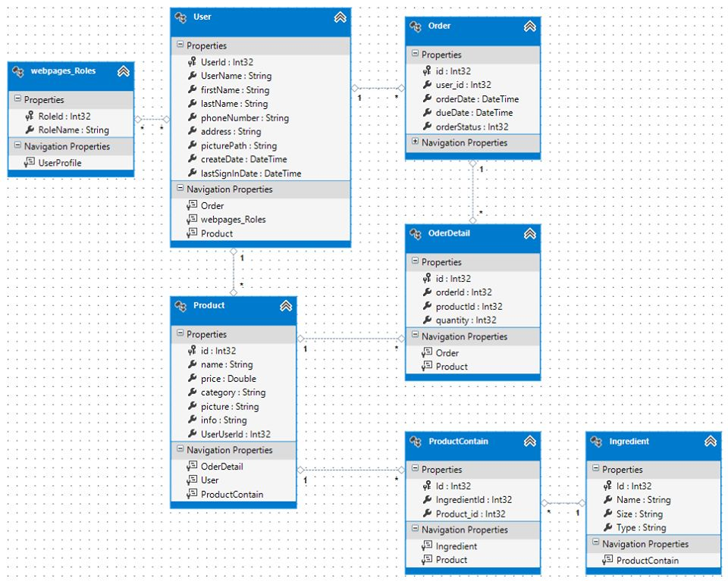
Example for database design

Slide 22
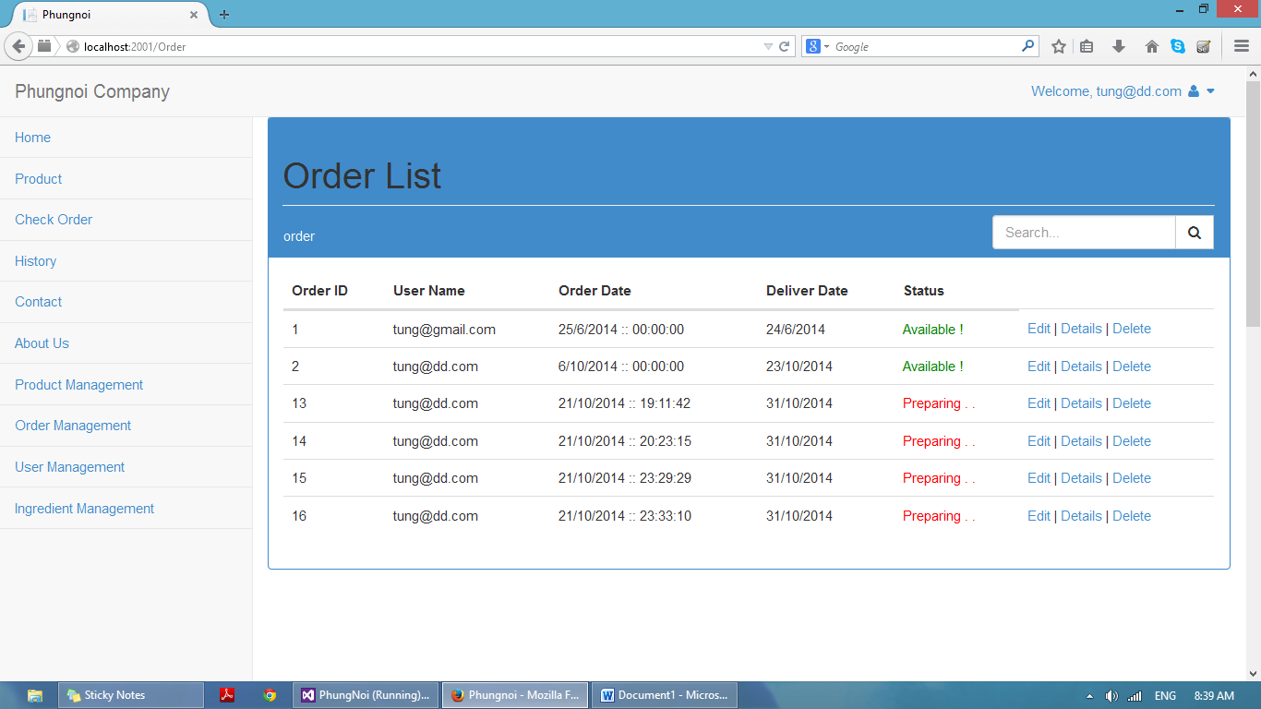
Example for user interface
UI – 24: Order list page

Slide 23
Tasks in Project Progress Repot II
Developing Tools
Develop software comply with SRS & SDD
Order Management
Ingredient Management
Software implement

Slide 24
Tasks in Project Progress Repot II
Test Plan Document
Test Plan
Test Record
Software testing

Slide 25
Example for unit testing
Unit Test Case-22 (UTC-22): public ActionResultDetails (int id = 0)
Description: This unit test case used to check Details (int id=0) method that can go to the correct page.
Test Cases:
No. | Description | Input | Expected output
1 | Return to an ingredient details page and valid ingredient id | {id == 2} | return View ("Details", {Name == “Raisin”, Size == 50, ingreID ==2, Category == Raisin, Picture == \\UploadImages\\210733446_10202588282381156_594892420_n.jpg});
2 | Return to an ingredient details page and Invalid ingredient id | {id == 500} | return HttpNotFound ();

Slide 26
Unit Test Record
No. | Expected output | Actual output | Pass/Fail
1 | return View ("Details", {Name == “Raisin”, Size == 50, ingreID ==2, Category == Raisin, Picture == \\UploadImages\\210733446_10202588282381156_594892420_n.jpg}); | return View ("Details", {Name == “Raisin”, Size == 50, ingreID ==2, Category == Raisin, Picture == \\UploadImages\\210733446_10202588282381156_594892420_n.jpg}); | Pass
2 | return HttpNotFound (); | return HttpNotFound (); | Pass

Slide 27
Example for system testing
System Test Case-12 (STC-12): Wholesaler can manage own order information by edit bakery product name, bakery product quantity and delivery date in the order.
Description: This test case is a system testing for URS-08. Wholesaler can manage own order information; bakery product name, bakery product quantity and delivery date in the order page.
Prerequisite: The wholesaler must has login to the system and current order information has been created.

Slide 28
No. | Description | Input | Expected output
1 | Test with input all correctly information to the order product form and order information can send into database. | Bakery product quantity: 340 Delivery Date: 13 October 2014 | Send new order information success and keep into the database. After that the system will redirect to details pages.
2 | Test with do not inputs bakery product quantity to the order product form. | Bakery product: “Difuku” Bakery product quantity: Delivery Date: 13 October 2014 | Send new order information unsuccessful and not keep into the database. After that the system give wholesaler input information again.
3 | Test with do not inputs delivery date to the order product form. | Bakery product: “Difuku” Bakery product quantity: 340 Delivery Date: | Display error message “The Delivery Date field is required.” After that the system give wholesaler input information again.
Test Cases

Slide 29
System Test Record
No. | Expected Result | Actual Result | Pass/Fail
1 | Send new order information success and keep into the database. After that the system will redirect to details pages. | Send new order information success and keep into the database. After that the system will redirect to details pages. | Pass
2 | Send new order information unsuccessful and not keep into the database. After that the system give wholesaler input information again. | Send new order information unsuccessful and not keep into the database. After that the system give wholesaler input information again. | Pass
3 | Display error message “The Delivery Date field is required.” After that the system give wholesaler input information again. | Display error message “The Delivery Date field is required.” After that the system give wholesaler input information again. | Pass

Slide 30
Example for Traceability Record Table
URS-09 | Wholesaler can view their current order’s information. | SRS-44 SRS-52 SRS-59 SRS-62 | UI-04 UI-22 UI-23 UI-25 | SD-13 | AD-18 | UC-09 | UTC-32 | STC-14
URS-10 | Admin can view current order’s information of all members by search keyword. | SRS-49 SRS-59 SRS-61 SRS-62 SRS-63 | UI-03 UI-23 UI-25 | SD-14 | AD-19 | UC-09 | UTC-30 UTC-31 UTC-33 | STC-15
Activity Diagram and User Requirement Specification

Slide 31


Demo

Slide 32
Problems
Lack Writing English skills.
Bad communication within team members.
Requirements might be change.
Unit test case not enough.
Have a problem with sequence Diagram
Too short time for implement
Deliverables delay.

Slide 33
Thank you for your attention

Slide 34
Q & A

